Slide 1
RU OUTER LENS HI LEVEL
Incoming Inspection Report
Incoming Inspection Performed by: Emmanuel Fernandez.
TOOL MAKER
Juárez , México
DATE: 11-17-2015

Slide 2
Tool General Information Identification Plaques.
Injection layout – Hot Runner System ,Plaques, tests .
Layout Cavity Side (Main appearances ).
Slides , Retractors , Lifters Details.
Layout Core Side (Main appearances ) .
Ejector System & Parts .
Locating Ring.
Electrical Plugs .
Water Leaks Test.
Spare Parts , Documents ,Tool manuals etc. Received .
Observations / Summary.
Quick Check List.

Slide 3
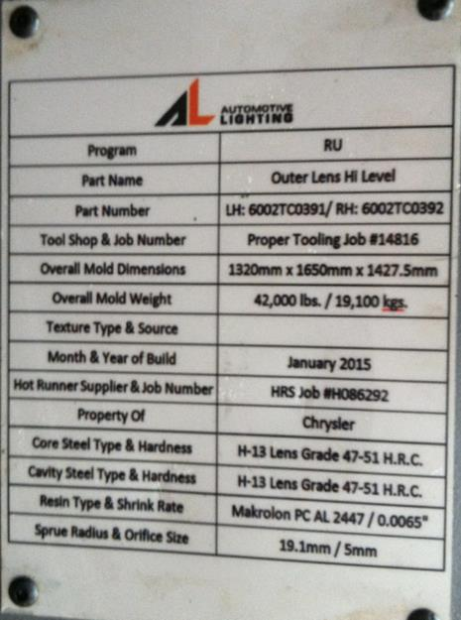
Tool Identification plate
✓
IDENTIFICATION
Tool Source : PROPER TOOLING
Job : 14816
Part Number: LH:6002TC0391/RH:6002TC0392
BACK TO INDEX

Slide 4
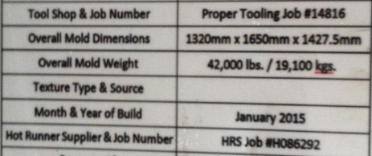
General Information
✓
Owner of Tool: Chrysler
MOLD WEIGHT: 19,100 kg.
MOLD SIZE (axbxc): 1320 mm X 1650 mm X
1427.5 mm
Nozzle radius: 19.1 mm
Injection diameter: 5 mm
BACK TO INDEX

Slide 5
Hot Runner System
✓
Hot Runner System #
HO95511.0
Zone Hot Nozzle system:
BACK TO INDEX

Slide 6
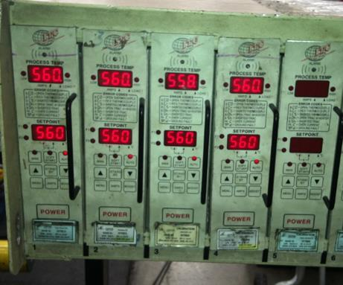
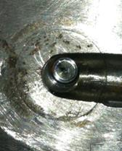
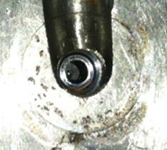
Hot Runner System Testing
✓
VALVE CLOSED
VALVE OPENED
all zones of the mold is heated to 560° F.
Testing the hot runner system comments:
All Zones Reached Its Proper Temperature, The Valve Is Moved Ok And Testing The Hot Runner System Everything Is Ok!
BACK TO INDEX

Slide 7
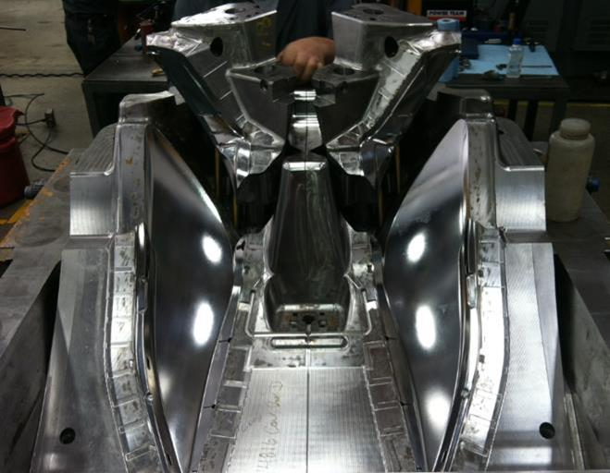
Lay outs – Cavity Side
Mold Cavity – How many Cavity ?
✓
The mold have 2 cavities (RH/LH)
BACK TO INDEX

Slide 8
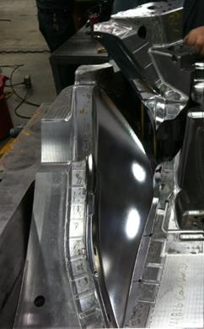
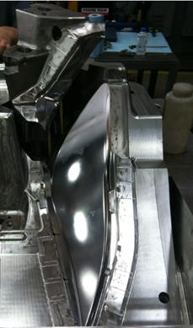
Lay out – cavity LH & RH
✓
CAVITY RH
CAVITY LH
Frontal View cavities RH & LH. Comments: No damages founded
BACK TO INDEX

Slide 9
Slides, Retractors , Lifters etc.
✓
The mold have lifters & slides
 |  |  | COMMENTS
NO. OF SLIDES |  |  | 2
DAMAGES |  |  | NO VISIVLE DAMAGRES
WATER LEAKS |  |  | NO WATER LEAKS
PLUGS - PRESS FIT OR THREADED
STOPPER
WATER CONNECTOR SIZE |  |  | ¼” NPT
MOVEMENTS |  |  | N/A
CAM PIN POSITION |  |  | N/A
SLIDE RETAINER |  |  | N/A
BACK TO INDEX

Slide 10
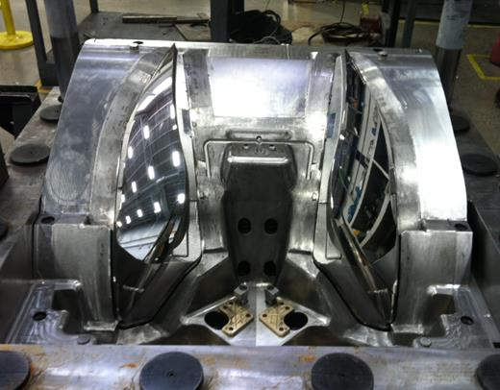
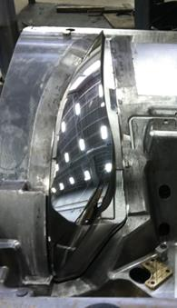
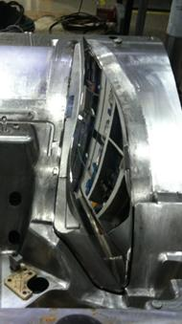
Core Layout
✓
LH
RH
Frontal View cores LH& RH, comments:
No visible Damage founded
BACK TO INDEX

Slide 11
Ejector System
✓
BACK TO INDEX

Slide 12
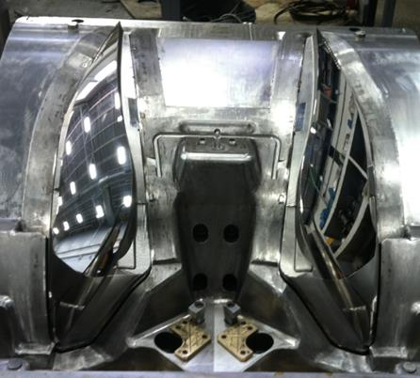
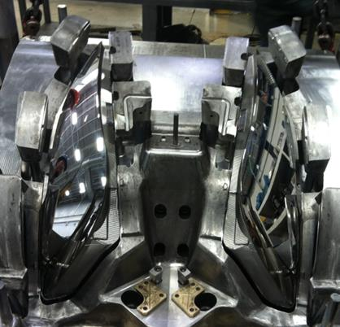
Ejector System
✓
Ejector system backward position picture
Ejector system forward position picture
Ejector System Tested ? , Back and Forward Position ?
The Ejector System Is Ok!
BACK TO INDEX

Slide 13
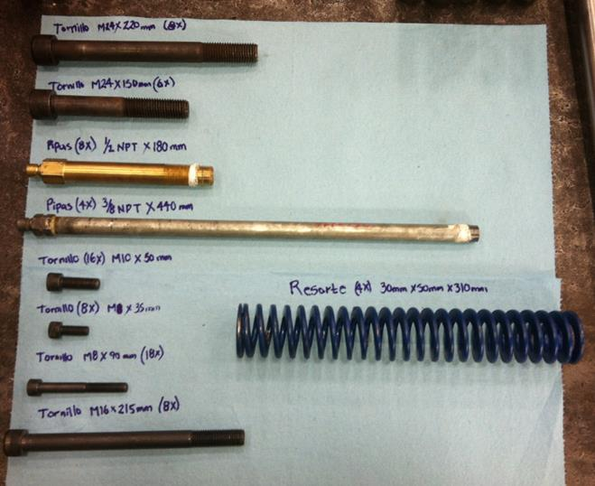
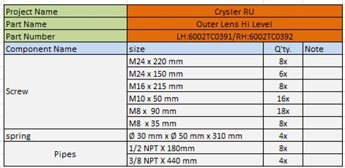
Ejector system parts and components
✓
BACK TO INDEX

Slide 14
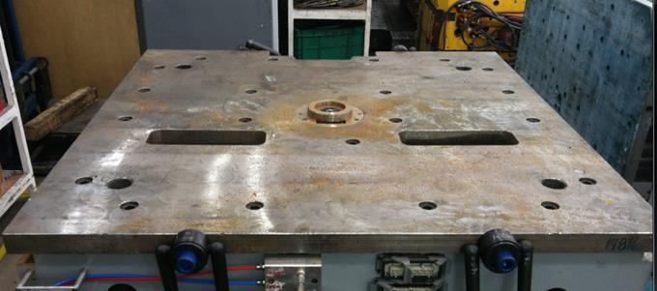
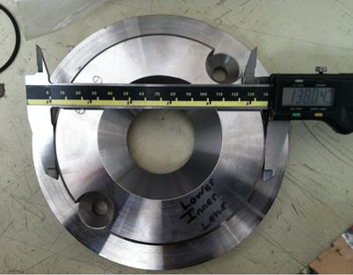
Locator Ring
✓
How many Locating rings ?
1
Sizes?
138.04 mm
BACK TO INDEX

Slide 15
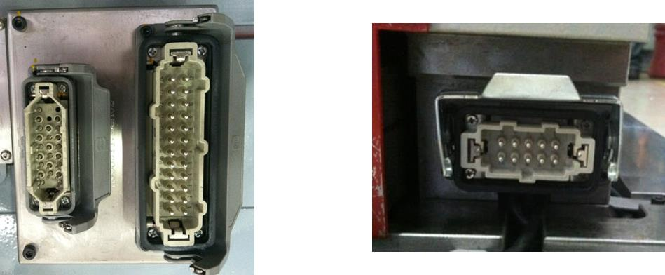
Electrical Parts
✓
Conector Plug for Hot Runner System.
Conector standard D-M-E per Heater and Thermocouples ?
for 4 zones
Conector standard For Limit Switch D-M-E?
4 for core #1 float plate and 2 for ejector plate.
heaters and thermocouple.
Limit Switch Connector
BACK TO INDEX

Slide 16
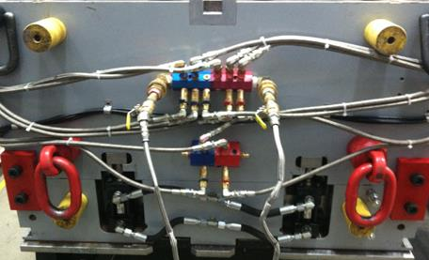
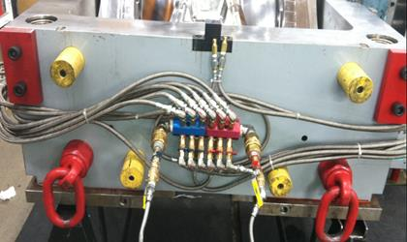
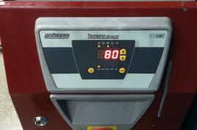
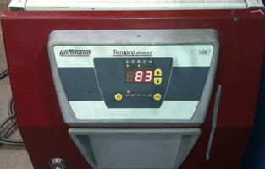
Water leak Testing
✓
CAVITY SIDE
CORE SIDE
Test Both sides of the tool with water at desired temperature ? comments:
THE CAVITY AND CORE SIDE ARE TESTED AT 85°C , NO WATER LEAKS
BACK TO INDEX

Slide 17
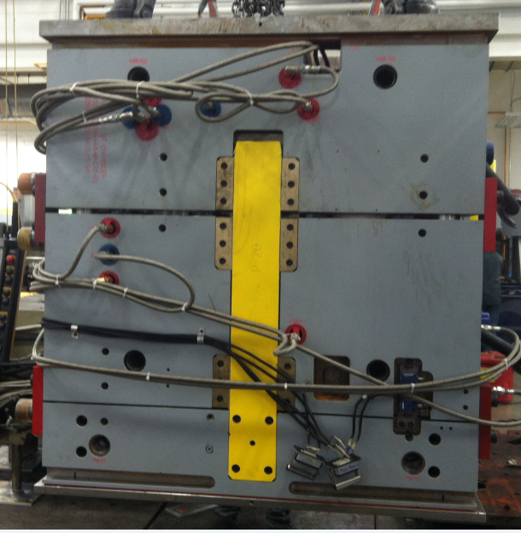
Spare parts ,Documents , Tool Manual etc. Received
✓
The mold arrived
BACK TO INDEX

Slide 18
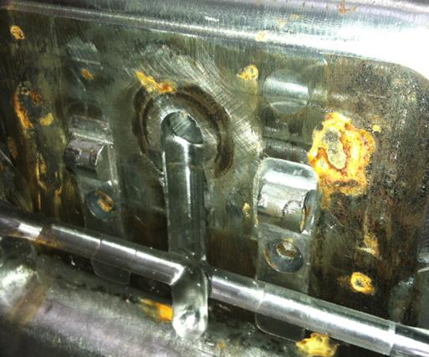
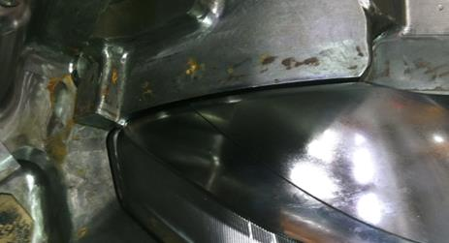
Observations
✓
In the incoming inspection not detected failures
The ejector system is working Ok.
The HRS is Ok.
El molde llega con oxido en zonas perifericas
BACK TO INDEX

Slide 19
Quick Checklist
L# | DESCRIPTION | YES | NO | N/A | COMMENTS / OBSERVATIONS
1 | LOCATING RINGS | ✓ |  |  | How many numbers? 1
2 | AIR VENTS & ITS DEPTH | ✓ |  |  | Availability of sufficient number of air vents? YES
3 | INTERLOCKS ( PARTING LINE LOCKS ) |  |  |  | How many? 2
4 | DATE INSERTS OR ENGRAVING |  | ✓ |  | Specify how many years?
5 | HOT RUNNER SYSTEMS NUMBER | ✓
6 | THERMOCOUPLE & RESISTANCE SPARES | ✓
7 | EJECTOR BLADES |  |  | ✓
8 | VALVE GATES AVAILABILITY |  |  | ✓
9 | ANGLE PINS FOR SLIDES | ✓
10 | LOCKING CYLINDERS AVAILABILITY |  |  | ✓
11 | SPRINGS ON EJECTION SYSTEM | ✓ |  |  | Color ? BLUE
12 | TEXTURES IN CAVITY |  | ✓
13 | IDENTIFICATION ON ALL PARTS | ✓
14 | HYDRAULIC PISTON FOR CORES | ✓
15 | LIMIT SWITCHES (MICRO SWITCH) | ✓
16 | RJG OR SPECIAL SENSORS |  | ✓ |  | Specify ?
17 | SAFETY LOCK
18 | INSERT CHANGES SPARES | ✓
19 | MOLD DRAWINGS & CD |  |  | ✓
BACK TO INDEX

Slide 20
Quick Checklist
MOLD NUMBER | 14816
PART NUMBER | LH:6002TC0391/RH:6002TC0392
PART NAME | OUTER LENS HI LEVEL
NO. OF CAVITIES | 2
CAVITIES MARKED NO.'S
TOOLING ENGINEER NAME
MOLD ARRIVAL DATE
MOLD INCOMING INSP. DATE
FREQUENCY FOR PM | N/A
PRESS ASSIGNED | N/A
BACK TO INDEX

